Slide 1
Integrated Project Data Science Development of an autocorrection system of bank checks

Slide 2






Our team
Youssef MANSOUR
Molka MRAD
Houssem OUERDIANE
Dhia BEN AMOR
Haithem GHARBI
Aicha CHAABA

Slide 3
Table of contents
01.
02.
03.
Problematic
Identifying and explaining the functional needs
Identifying and explaining the non-functional needs
04.
05.
Development Constraints
Conclusion

Slide 4
Problematic
01

Slide 5
Problematic
Client
Bank Agent
Non-matching amount in letters and in numbers
Syntax Mistakes
Invalid date
Forgetting to fill a part of the check
Cross-outs
Unreadable handwriting
Different types of checks
Different format of writing,dimesion,colors,police,language,…
Slow processing

Slide 6
Identifying the functional needs
02

Slide 7
Achieve the autocorrection of the amount in a check
Manipulate a huge amount of data
Assure the security in the whole process

Slide 8
Detection of the different parts of the check
Comparison between the amount in numbers and the amount in letters
Verifying the validity of the date (the check expires after 3 years and a week)

Slide 9
Check the existence of the signature and its validity
Identify the language written in the check
Identify different handwritings

Slide 10
Identifying the non-functional needs
03

Slide 11
Computer Vision
CNN
NLP
SVM

Slide 12
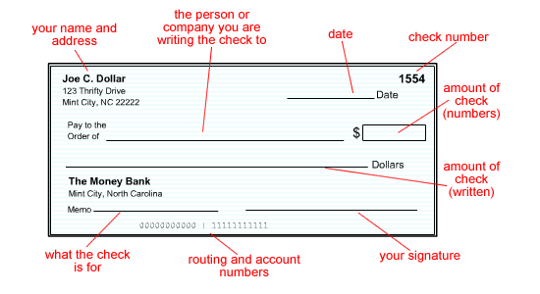
Computer Vision
Preprocessing
Segmentation
To perform image processing on digital images
To improve the image data (features) by suppressing unwanted distortions and/or enchancement of some important image features
Capturing the components of a scanned bank check image

Slide 13
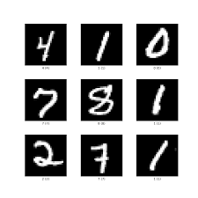
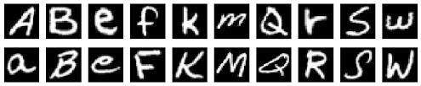
Convulitional Neural Network (CNN)
Identifying the digits from courtesy amount image segment and characters from legal amount segment using CNN EMNIST dataset for Latin letters and MNIST dataset for numbers

Slide 14
Natural Language Processing NLP
NLP is the field of Artificial Intelligence that relates lingual to Computer Science, in which we will :
Identify mispekked words
Find distance away
Filtering
Calculate probabilities of words

Slide 15
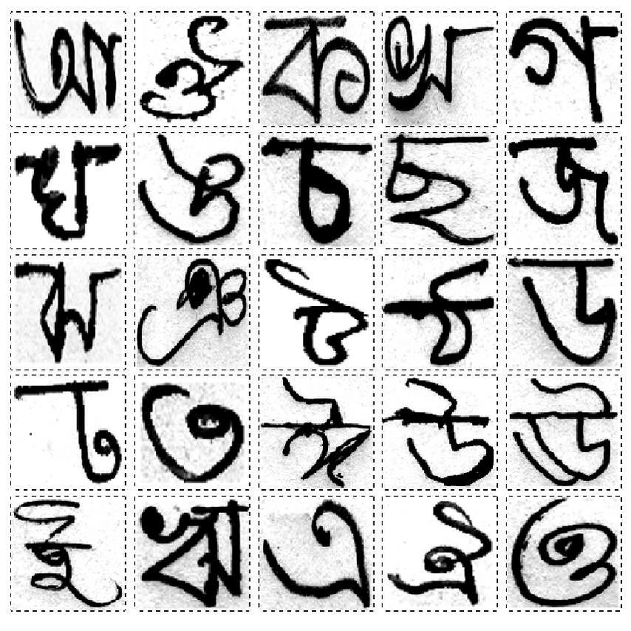
Support Vector Machine & Scale Invariant Feature Transform : SVM & SIFT
For verification of signature, we will use SIFT for extraction of the features and SVM as a classifier with a dataset named BANGLA that contains signatures

Slide 16
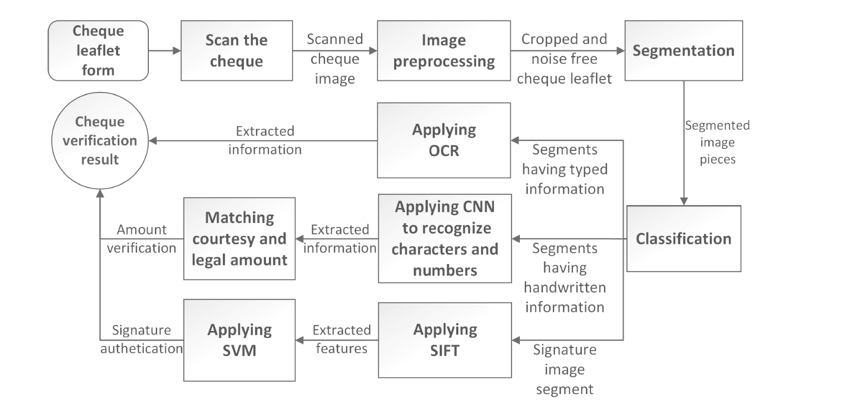

To conclude it all

Slide 17
Development Constraints
04

Slide 18
Constraints
Confidentiality of bank clients
Diversity of check layouts
Budget limits
Security of the system
High-availability of the server
Reduce the amount of paper used in checks

Slide 19
Conclusion
05

Slide 20
Thanks!
Do you have any questions?

